Slide 1
Family Tree
Academic descendants of Meir Feder

Slide 2
Lab 102(4)
A.k.a. “Information Theory Lab”
(Used to be known as “Signal Processing and Multimedia Lab”…)
Anyone affiliated to it knows that we’re all one big happy family
Even when we’re in Pasadenaexile… ☺
Or in HUJIa different university
What some do not know is that the one who created this lab is Meir

Slide 3
Mathematics Genealogy Project
http://genealogy.math.ndsu.nodak.edu/
An effort to build a complete mathematical family tree
If you’re not in it you don’t existplease add yourself
(+students)
Yes, IT counts as math
SP?
Probably too ☺

Slide 4
Mathematics Genealogy Project
For a small fee (70$) you can get a poster of your academic tree
We could pay the fee (Meir has a lot of academic decendants :)
But it wouldn’t be as fun
Instead we triggered and parsed their webpage and created the tree for free
Hail MatlabPython!

Slide 5
Academic Descendants
Newton: “If I have seen further, it is by standing on the shoulders of giants.”
Or for the Latin speakers among us: “Nanos gigantum humeris insidentes.”

Slide 6
Academic Descendants
Warning: (Very) partial list!
Many of Meir’s descendants are in the audience
Others are preparing slides to compensate for their absence ☺

Slide 7
Academic Ancestors
You probably know most of the names in the previous tree…
What about ancestors?

Slide 8
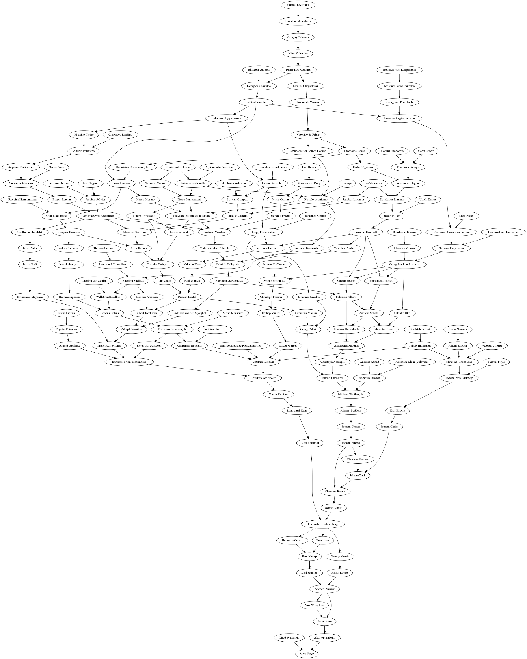
Ancestor Tree
Alen Oppenheim
Explains the writing
Amar Bose
Explains the business acumen
Norbert Weiner
Explains why he taught the estimation course last year ☺
Hermann Cohen and Immanuel Kant
Explains the philosophical discussions about probability with Yuval Lomnitz
Gottfried Leibniz
Explains the mathematical skills
Also, that’s why we believe the “standing-on-giants” sentence is due to Leibniz
Manuel Bryennios (1275-1340) – Byzantine scholar
That explains the age ☺

Slide 9
A Complete List of Names
Johannes von Gmunden, Joseph Scaliger, Gaetano da Thiene, Bonifazius Erasmi, Rutger Rescius, Thomas a Kempis, Yuk-Wing Lee, Gemma Frisius, Willebrord Snellius, John Craig, Friedrich Trendelenburg, Justus Lipsius, Jan Stampioen, Jr., Salomon Alberti, Antonio Brasavola, Karl Reinhold, Manuel Bryennios, Ehrenfried von Tschirnhaus, Johann Christ, Johannes Caselius, Christiaan Huygens, Francois Dubois, Arnold Geulincx, Heinrich von Langenstein, Christian Kustner, Gregory Palamas, Vittorino da Feltre, Thomas Cranmer, Amar Bose, Leonhard von Dobschutz, Rudolph Snellius, Ernst Laas, Andreas Kunad, Immanuel Kant, Pelope, Jacques Toussain, Ambrosius Rhodius, Johannes Volmar, Jacobus Arminius, Johann Reuchlin, Paul Natorp, Johannes Regiomontanus, Florens Radewyns, Guarino da Verona, Jan van Campen, Emmanuel Stupanus, Christoph Notnagel, Jacobus Sylvius, Felix Plater, Jacobus Latomus, Pietro Pomponazzi, Johann Gesner, Pieter van Schooten, Adolph Vorstius, Bassiano Landi, Sigismondo Polcastro, Guillaume Bude, Georg Joachim Rheticus, Vittore Trincavelli, Josiah Royce, Johannes Argyropoulos, Ulrich Zasius, Theodor Zwinger, Johannes Stoffler, Valentine Naibod, Ehud Weinstein, Christian Thomasius, Johannes von Andernach, Maarten van Dorp, Johann Hoffmann, Michael Walther, Jr., Karl Knorre, Gilbert Jacchaeus, Karl Schmidt, Rudolf Agricola, Johann Buddeus, Leo Outers, Petrus Ramus, Nilos Kabasilas, Jan Standonck, Christian Heyne, Matteo Realdo Colombo, Janus Lascaris, Thomas Erpenius, Angelo Poliziano, Valentin Alberti, Cristoforo Landino, Josias Neander, Immanuel Tremellius, Matthaeus Adrianus, George Morris, Hermann Cohen, Georg von Peuerbach, Marin Mersenne, Jacob ben Jehiel Loans, Luca Pacioli, Alexander Hegius, Giovanni Battista della Monte, Moritz Steinmetz, Moses Perez, Abraham Klein (Calovius), Georgios Gemistos, Demetrios Chalcocondyles, Erhard Weigel, Friedrich Leibniz, Nicolaus Copernicus, Cornelius Martini, Franciscus Sylvius, Johann Rhetius, Philipp Melanchthon, Niccolo Leoniceno, Philipp Muller, Desiderius Erasmus, Sebastian Dietrich, Melchior Jostel, Valentin Thau, Bartholomaus Schwendendorffer, Andreas Vesalius, Ludolph van Ceulen, Gottfried Leibniz, Johann Bach, Girolamo Aleandro, Jean Tagault, Nicoletto Vernia, Christian von Wolff, Paul Wittich, Marsilio Ficino, Theodoros Gazes, Frans van Schooten, Jr., Guillaume Rondelet, Nicolas Clenard, Christoph Meurer, Domenico Novara da Ferrara, Duncan Liddel, Theodore Metochites, Petrus Ryff, Andreas Schato, Johannes Sturmius, Georgius Hermonymus, Valentin Otto, Basilios Bessarion, Norbert Wiener, Marco Musuro, Hieronymus Fabricius, Ognibene Bonisoli da Lonigo, Johann Ernesti, Alan Oppenheim, Scipione Fortiguerra, Samuel Stryk, Petrus Curtius, Erasmus Reinhold, Martin Knutzen, Caspar Peucer, Jacobus Golius, Gabriele Falloppio, Johann von Ludewig, Demetrios Kydones, Georg Calixt, Pietro Roccabonella, Elissaeus Judaeus, Adriaan van den Spieghel, Manuel Chrysoloras, Ernestus Hettenbach, Georg Konig, Adrien Turnebe, Erycius Puteanus, Geert Groote, Jakob Milich, Johannes Hommel, Aegidius Strauch, Jakob Thomasius, Johann Quenstedt, Meir Feder (trivial case)…

Slide 10
Ancestor Tree
No it does not satisfy the “tree assumption”…
Yes it has a very small girth…

Slide 11
Happy birthday and thank you
from the 102-lab family!

